Slide 1
Economic Leadership Summit
Welcome

Slide 2
Agenda
Buffet Lunch
Welcome and Logistics Mr. Richard Hernandez
Why We Are Here Mr. Rodney Jenkins
The Demographics of Dr. Tom Hughes
Yavapai County
A Case for Regional Mr. Trevor Stokes
Collaboration
Next Steps and Open Dr. Ron Liss
Discussion
Economic Leadership Summit

Slide 3
Mr. Rodney Jenkins
Yavapai College Vice President
Community Relations
Economic Leadership Summit

Slide 4
Dr. Lisa Rhine
Yavapai College President
Economic Leadership Summit

Slide 5
Dr. Tom Hughes
Director, Institutional Effectiveness and Research
Yavapai College
Economic Leadership Summit

Slide 6
Regional Demographics & Labor Force
Economic Leadership Summit

Slide 7
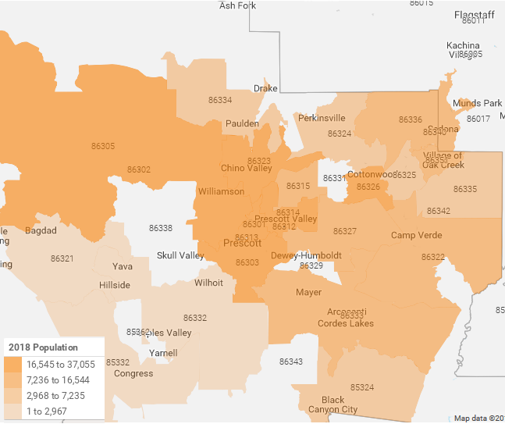
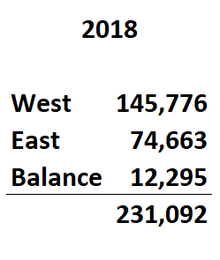
Yavapai County Population
Economic Leadership Summit
Source: EASI Analytics, Inc., 2018

Slide 8
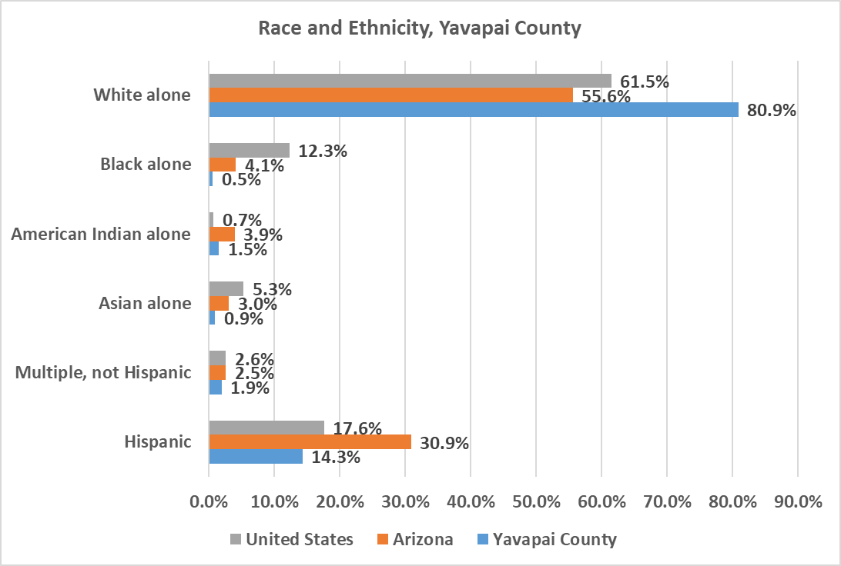
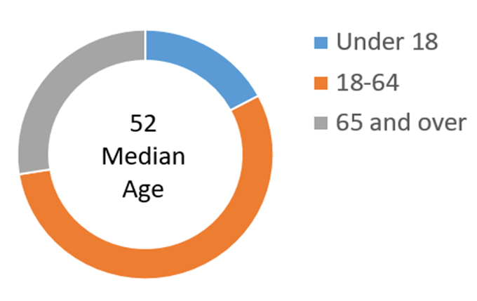
Demographics
Source: U.S. Census Bureau, 2013-2017 American Community Survey 5-Year Estimates
Economic Leadership Summit

Slide 9
Challenges “Future Opportunities”
Economic Leadership Summit

Slide 10
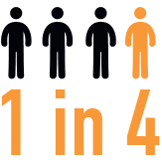
Financial Insecurity
Yavapai County Residents Lives in Near Poverty
Source: U.S. Census Bureau, 2013-2017 American Community Survey 5-Year Estimates

Slide 11
Near Poverty by Community
Source: U.S. Census Bureau, 2013-2017 American Community Survey 5-Year Estimates
Economic Leadership Summit
Notes:
As indicated in prior slide, people in poverty are spread throughout the county

Slide 12

Official poverty level is so understated

Slide 13
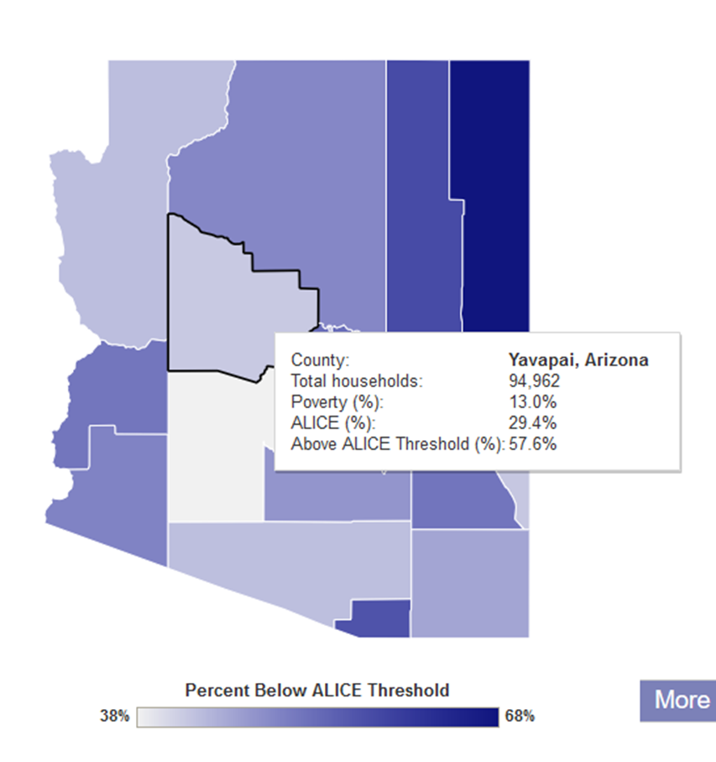

ALICE in Yavapai County
Source: www.unitedwayalice.org/in-the-us

Slide 14
Education
Economic Leadership Summit

Slide 15
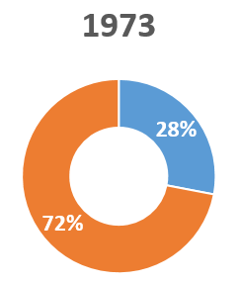
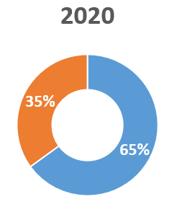
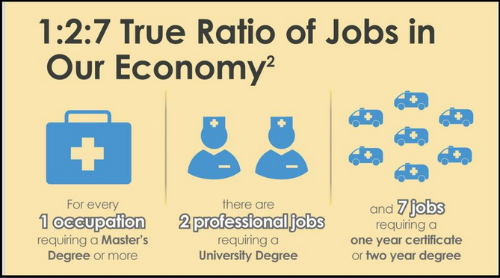

Job Education and Training Requirements
Source: Georgetown University Center on Education and the Workforce
Source: www.explorethetrades.org

Slide 16
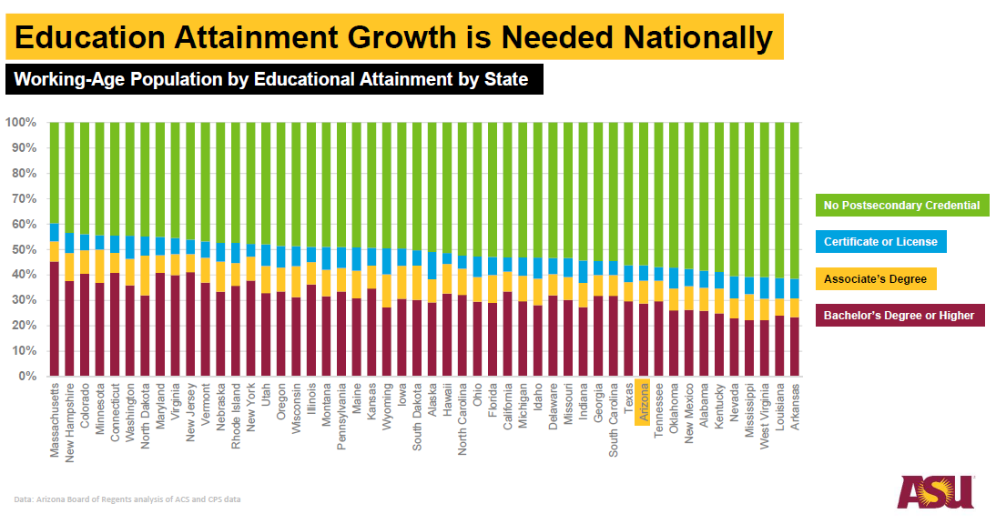

Slide 17


Secondary Trends
Challenged K-12 system
Economic Leadership Summit

Slide 18
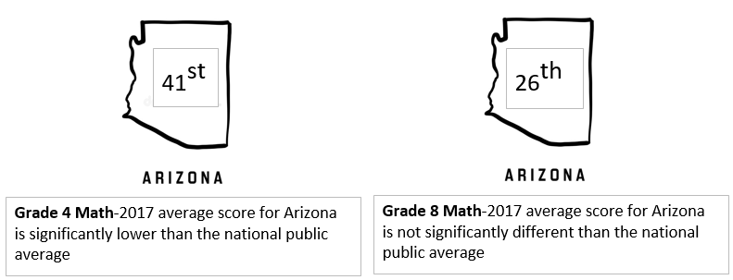
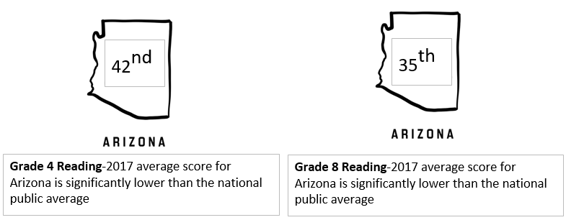
AZ Student Performance
Economic Leadership Summit
Source: U.S. National Center for Education Statistics, National Assessment of Educational Progress 2017

Slide 19
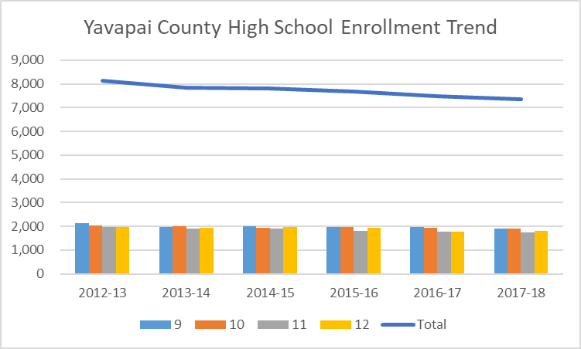
High School Enrollment
Economic Leadership Summit
Source: Arizona Department of Education, 2012-13 – 2016-17; YC Office of Institutional Effectiveness and Research Forecast 2017-18

Slide 20
Regional Economic Landscape
Economic Leadership Summit

Slide 21



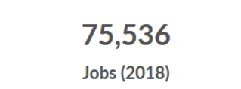
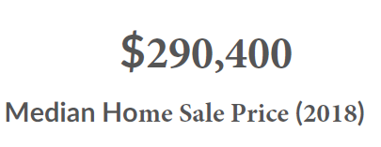
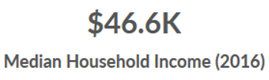
Economy Overview
Source: Economic Modeling Systems International (EMSI), 2018
Economic Leadership Summit

Slide 22
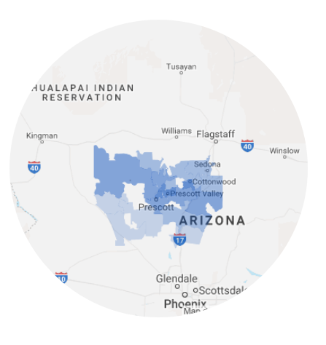
Labor Force
104,747
33,519
71,228
Source: Economic Modeling Systems International (EMSI), 2018
Economic Leadership Summit

Slide 23
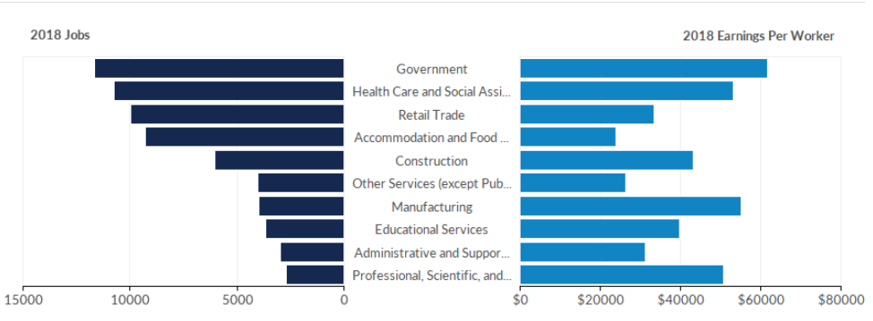
Largest Industries
Source: Economic Modeling Systems International (EMSI), 2018
Economic Leadership Summit

Slide 24
Education and Economic Investment
Economic Leadership Summit

Slide 25
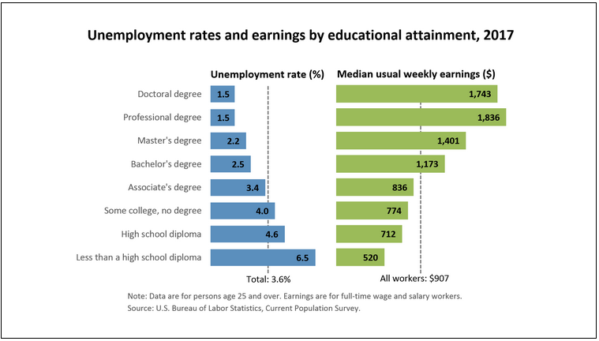
Educational Attainment, Earnings, Unemployment
Economic Leadership Summit

Slide 26
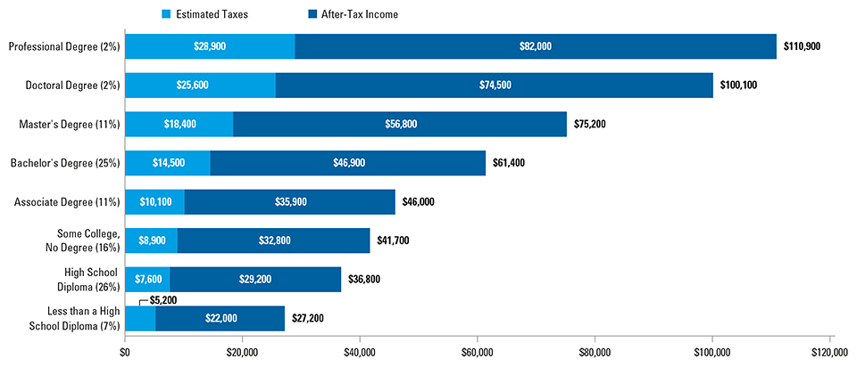
Educational Attainment, Median Earnings, Tax Payments
SOURCE: The College Board, Education Pays 2016, Figure 2.1
Economic Leadership Summit

Slide 27
Educational Attainment & Social Benefits
Educational Attainment
Social Benefits/Savings
Reduced prevalence of alcohol dependence or abuse
Reduced prevalence of smoking
Reduced prevalence of frequent mental distress
Reduced prevalence of illicit drug dependence
Reduced Medicaid
Decreased incarceration rates
Declines in Temporary Assistance for Needy Families (TANF) applicants
Declines in Supplemental Nutrition Assistance Program (SNAP) applicants
Reduced Supplemental Security Income (SSI)
Reduced unemployment insurance
Professional Degree
Doctoral Degree
Masters Degree
Bachelors Degree
Associates Degree
Some College, No Degree
High School
Less than High School
Economic Leadership Summit

Slide 28
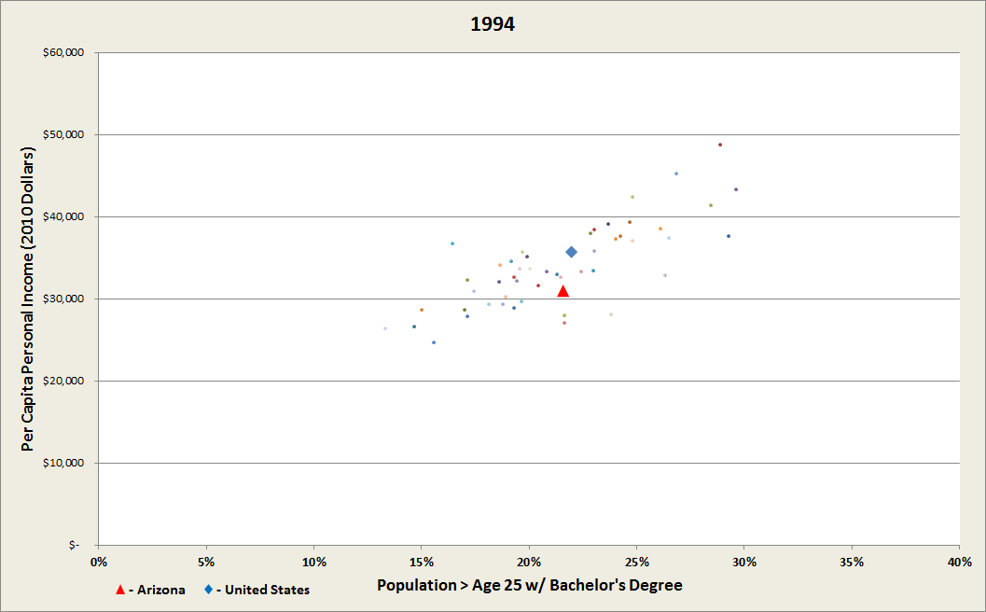
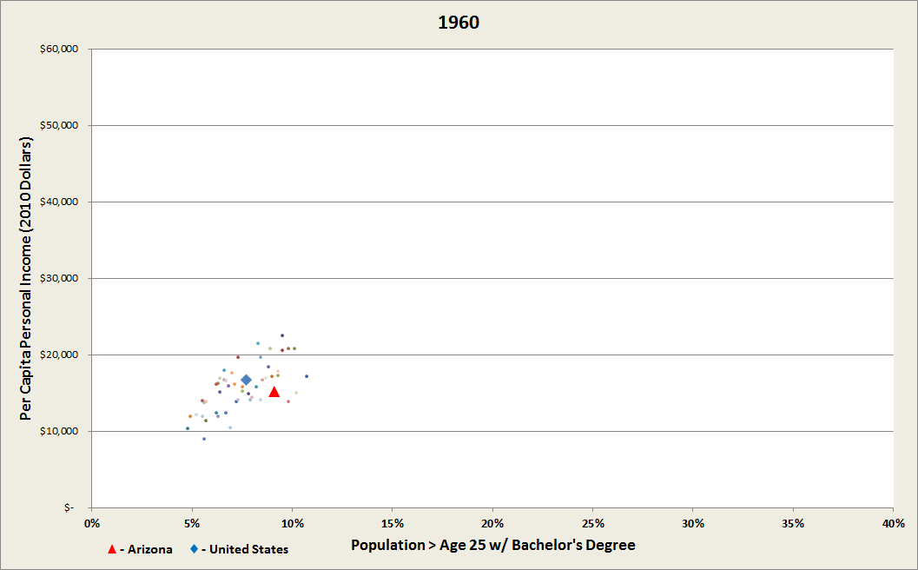
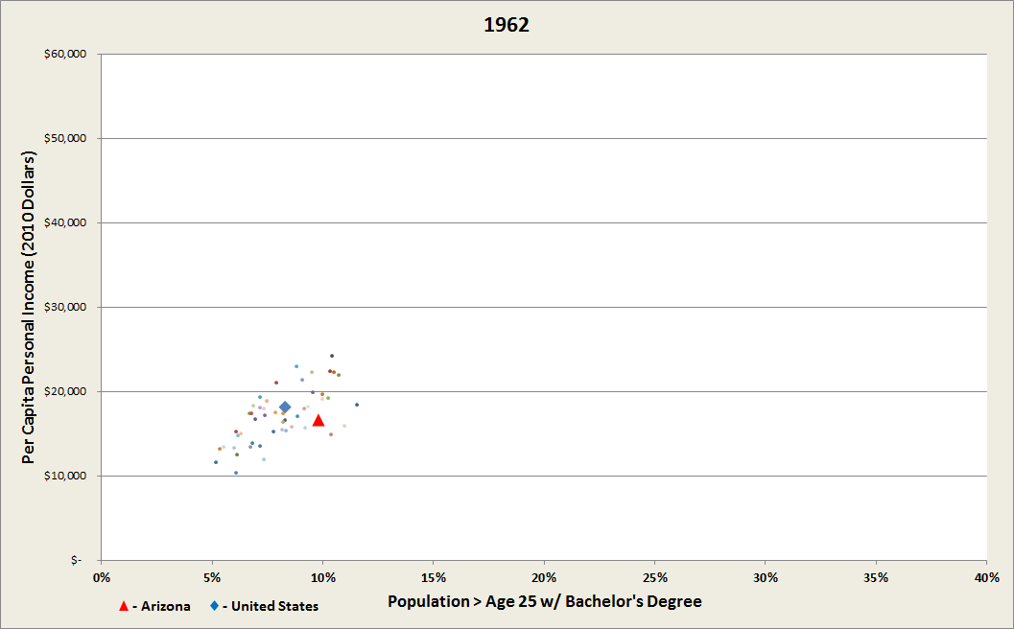
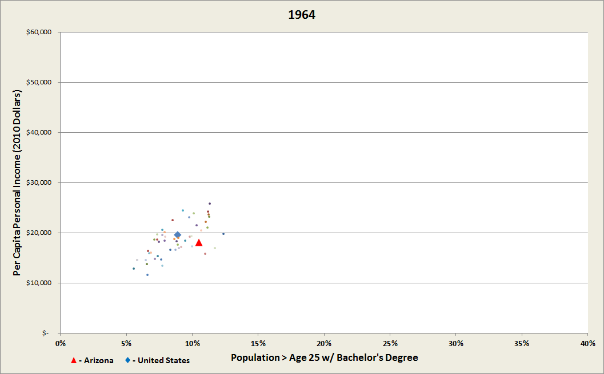
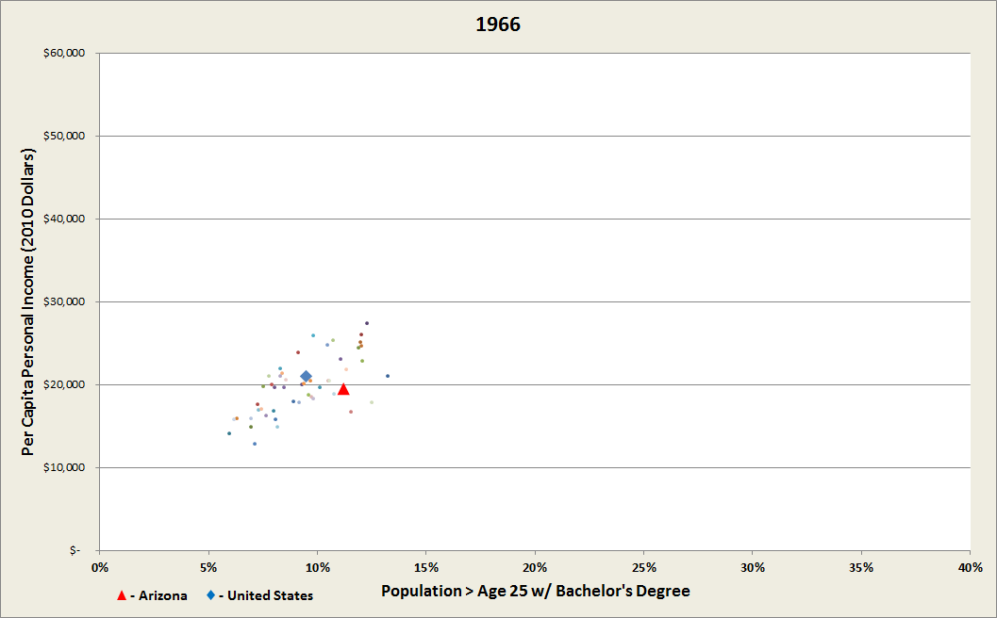
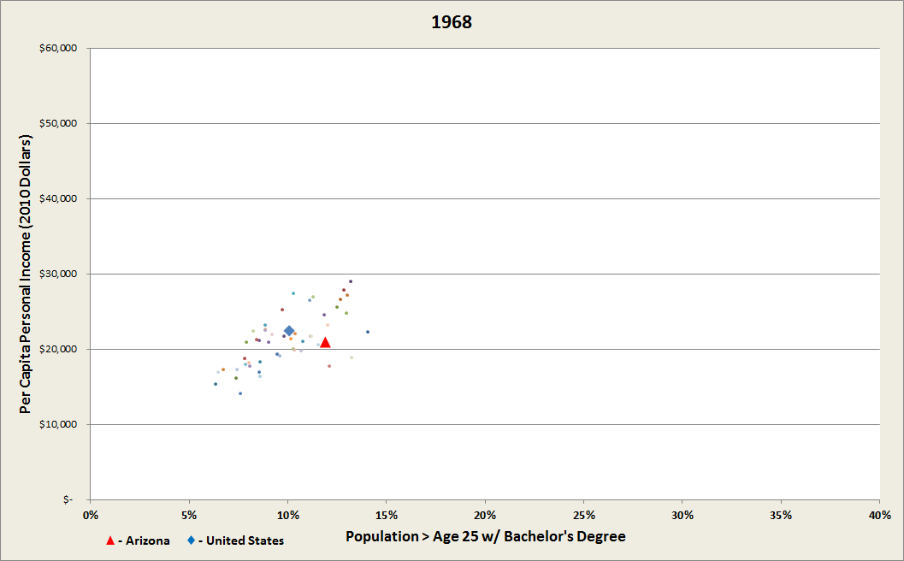
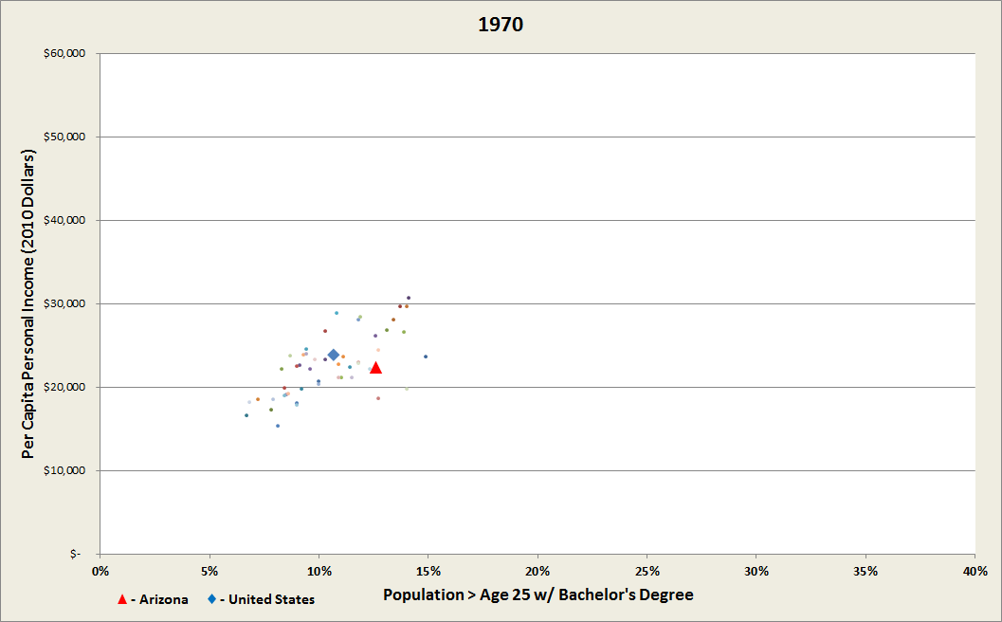
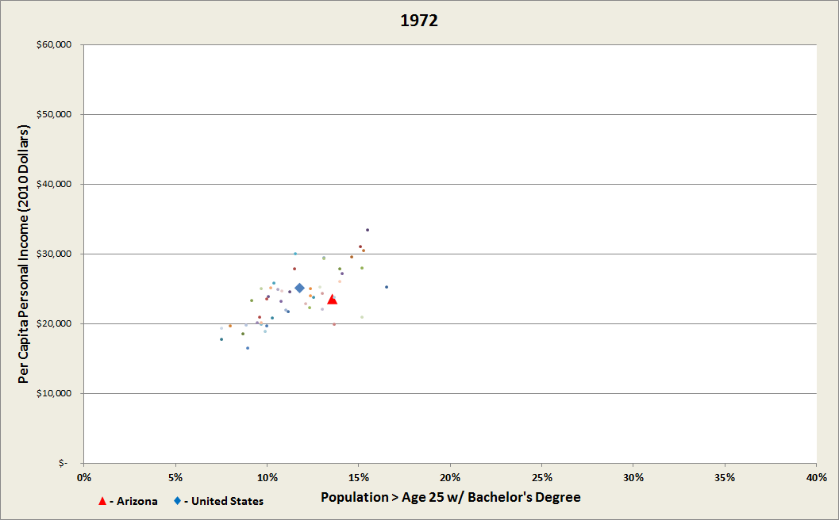
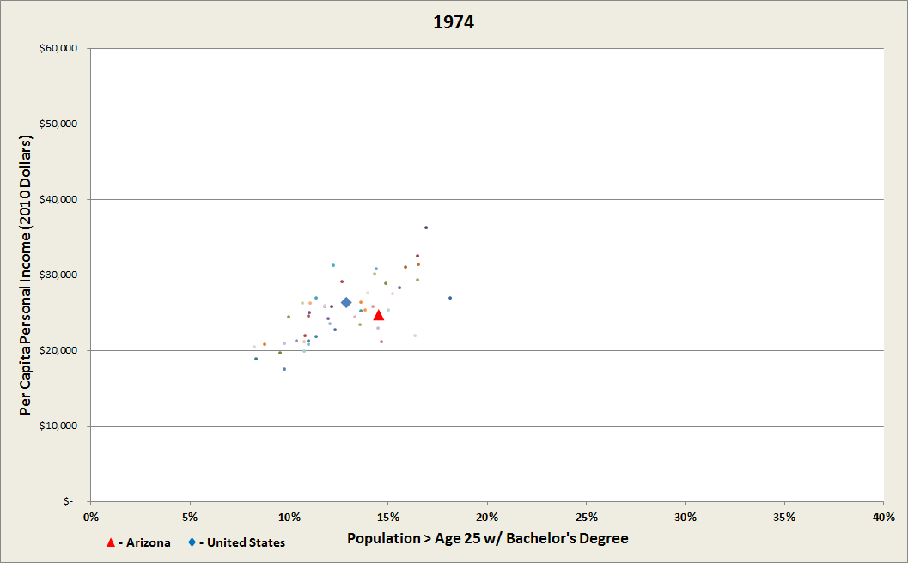
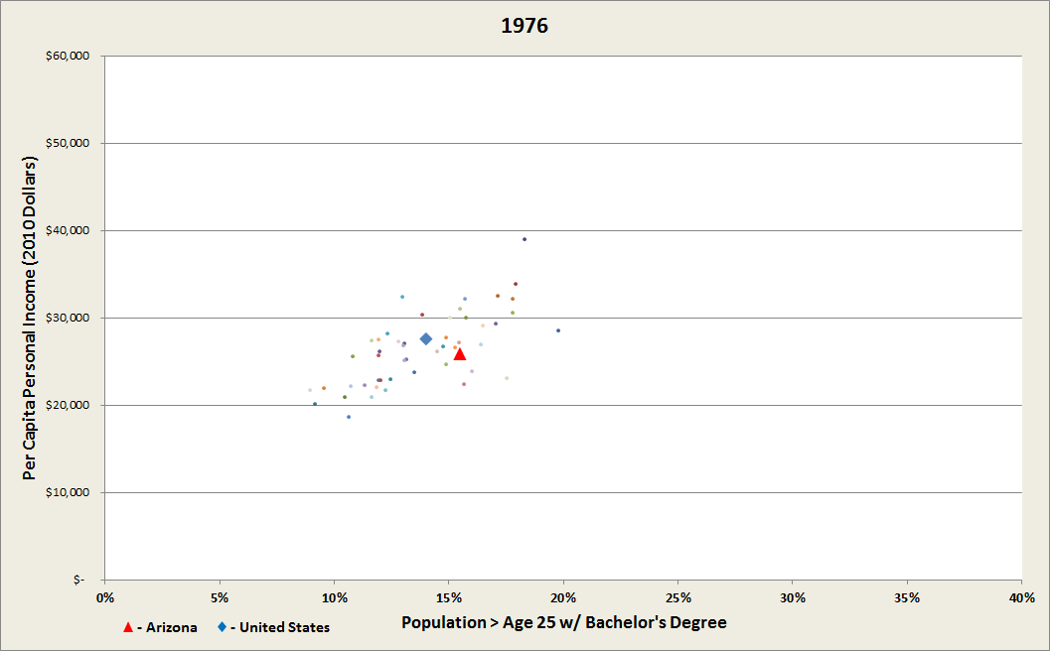
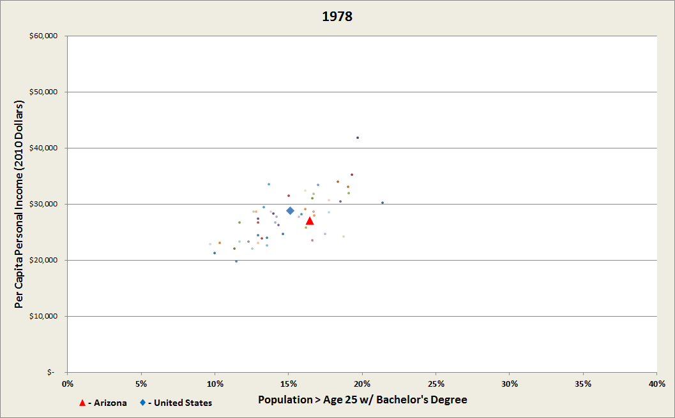
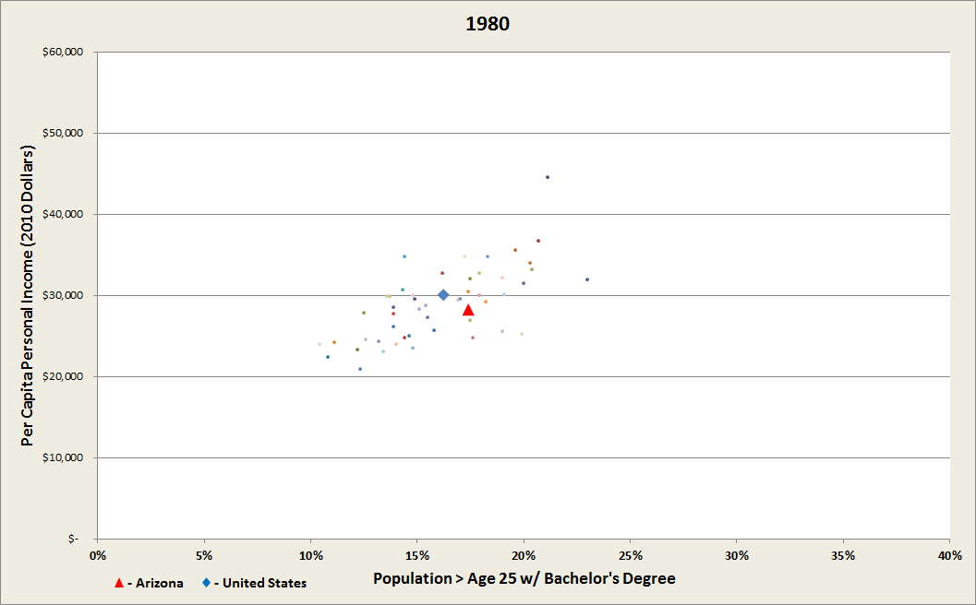
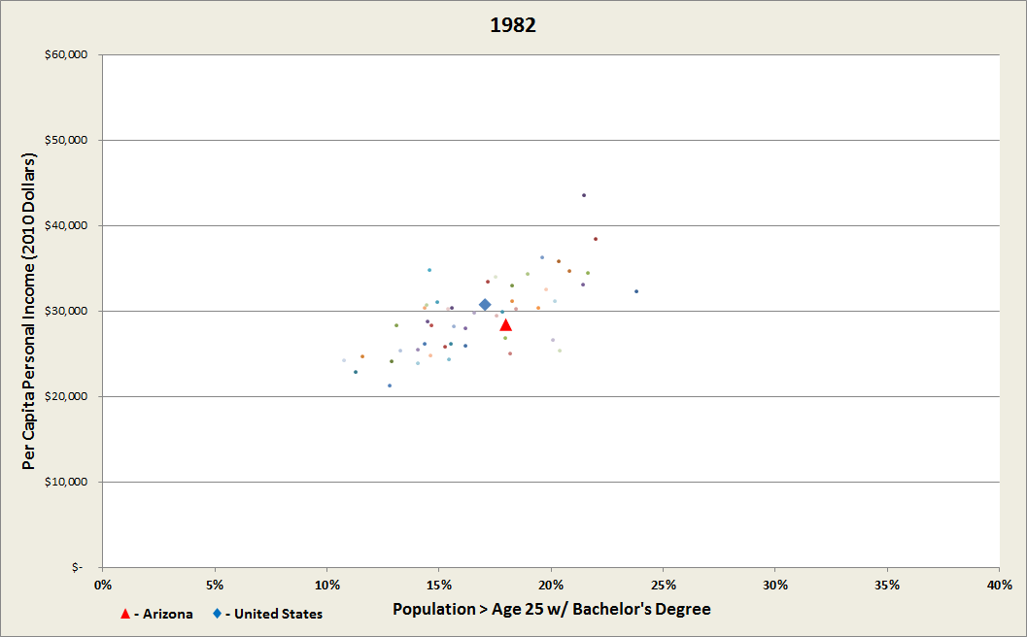


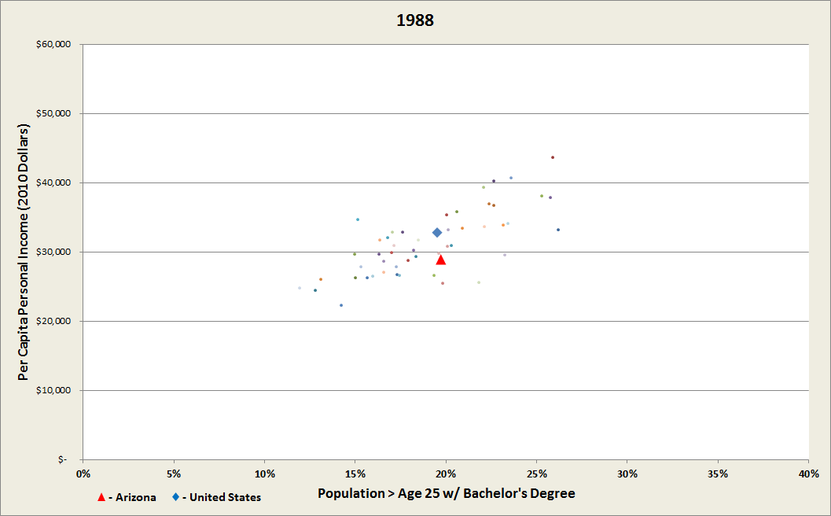
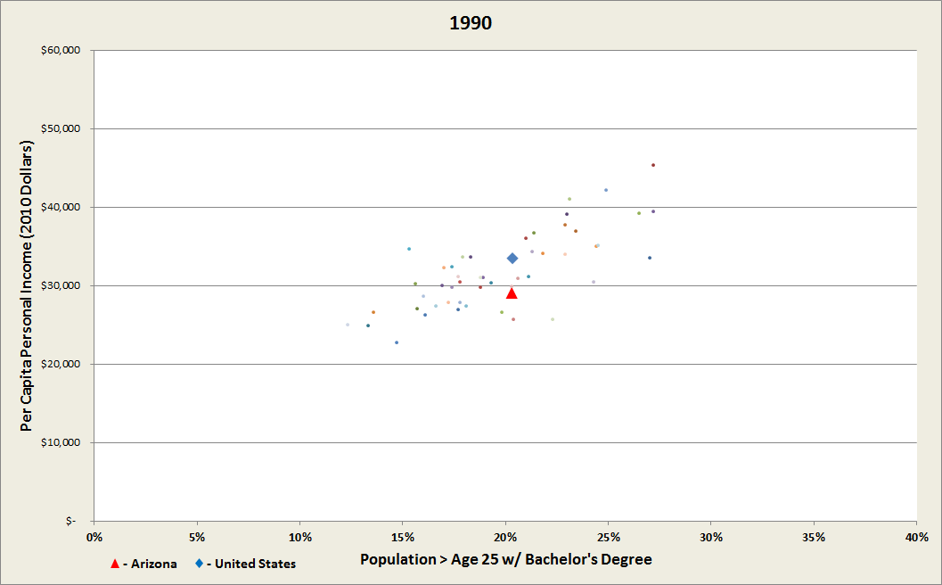

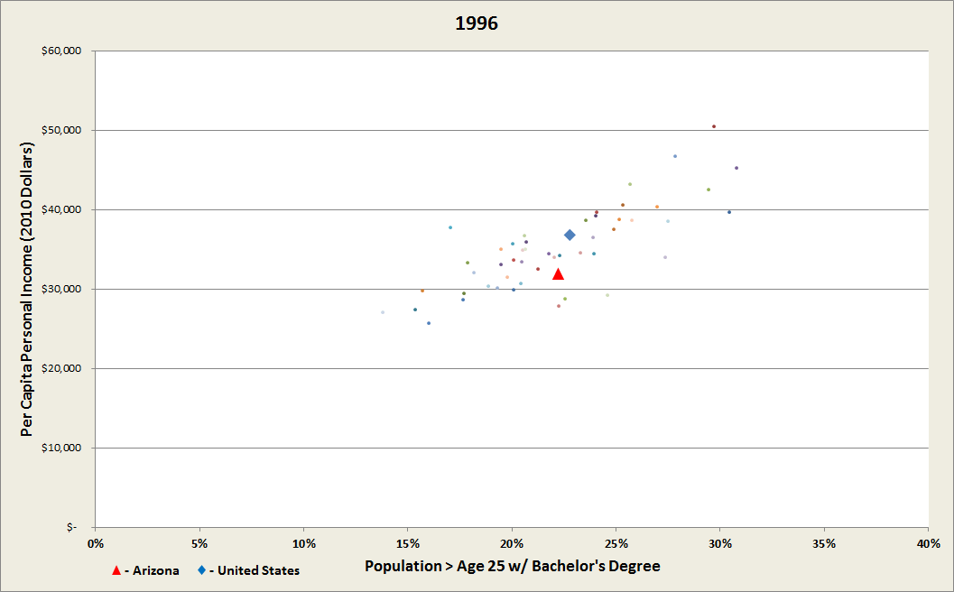

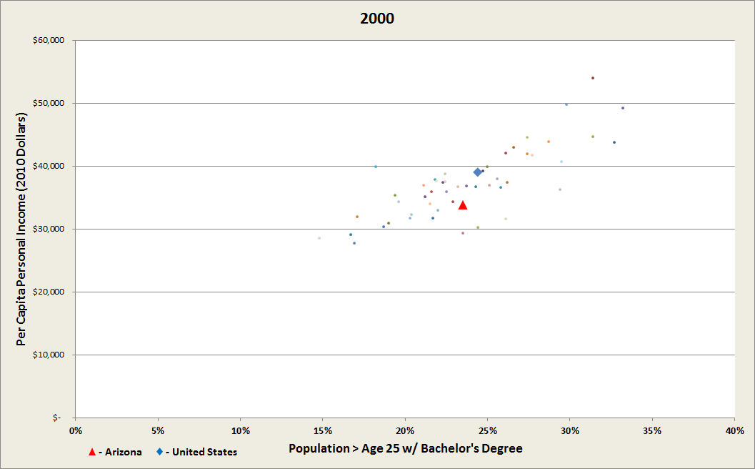

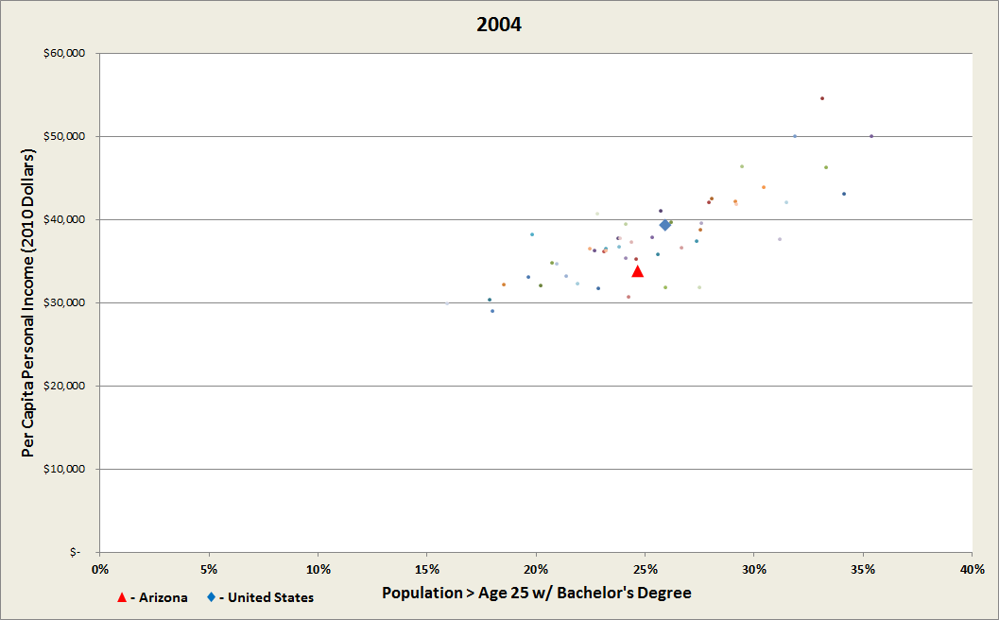
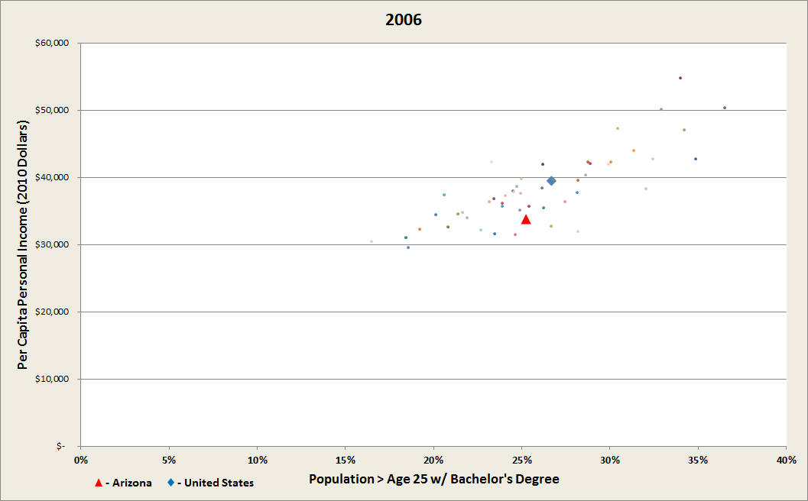
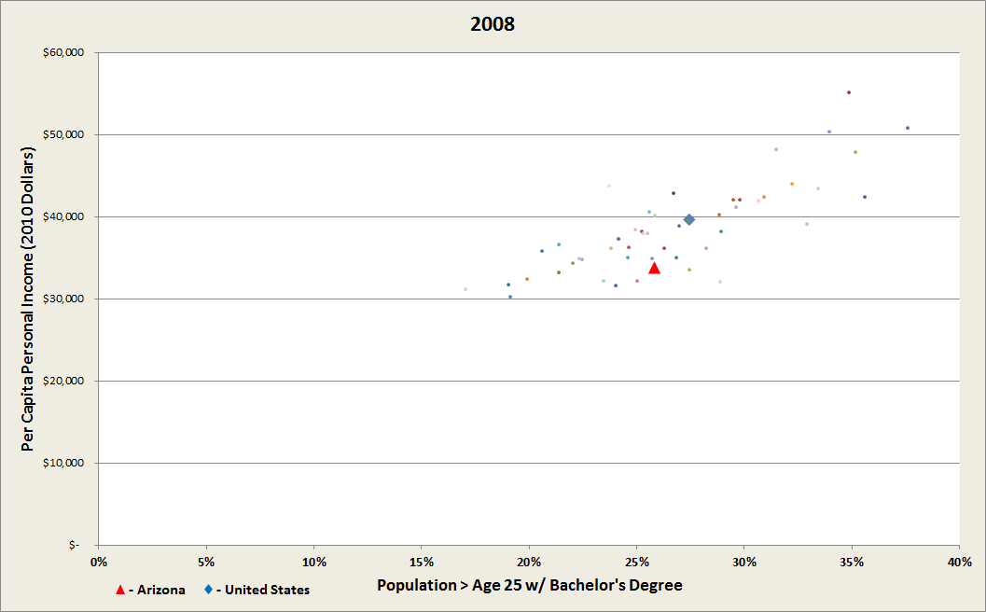

Educational Attainment and Prosperity: 1960-2010
Source: U.S. Census and Bureau of Economic Analysis
Economic Leadership Summit
Courtesy of Dan Hunting
Notes:
Arizona is the red triangle and the national average is the blue diamond.
Notice that in 1960, Arizonans were a little poorer than the national average, but somewhat better educated. 9.1% in the state had Bachelor’s degrees, with just 7.7% nationally.
Now I’m going to animate these dots to show how the picture changes over time.
Keep an eye on Arizona’s red triangle and the blue diamond showing national average to see how we do.<CHANGE>

Slide 29
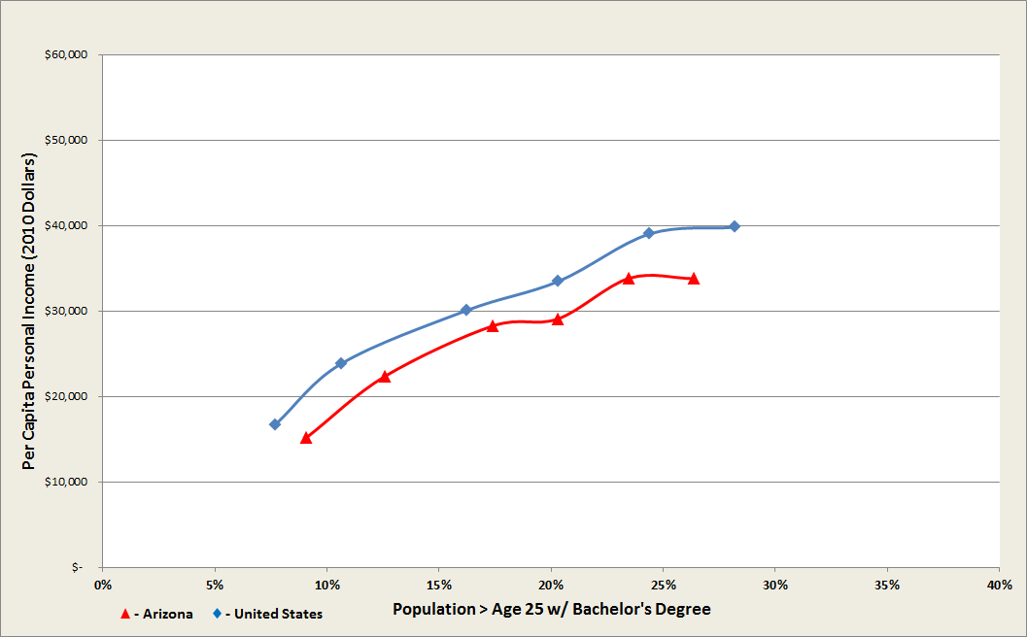

Arizona’s Trajectory: 1960-2010
2000
2010
1990
1980
1970
1960
A 1% increase in Bachelor’s Degree rate
translates to a $1,000 increase in per capita personal income for everyone.
Source: U.S. Census and Bureau of Economic Analysis
Economic Leadership Summit
Courtesy of Dan Hunting
Notes:
What we just saw was Arizona’s trajectory of education and prosperity over the past 50 years.
Now let’s take away the other states and look at how our state performed versus the nation as a whole.
As I said, in 1960 our income was a little lower than average, but we had more college graduates than most. <CHANGE>
By 1970, we’d made gains in closing the income gap and increased our educational attainment. <CHANGE>
In 1980, we were just holding our ground on income, and while our education is still above average, it’s not rising so rapidly. <CHANGE>
By 1990, our income has started to slip significantly against the nation and our educational attainment has dropped to the national average. <CHANGE>
In 2000, our income is clearly below the national average while our educational attainment has dropped below average for the first time. <CHANGE>
Finally, in 2010 both our income and education levels show a clear trend away from the national average.
Note that both our income and education increased dramatically over this period.
But although a two and a half times increase in the bachelor’s rate sounds great at first, we have to ask ourselves if that is good enough performance when the country increased it’s rate by three and half times. <CHANGE>

Slide 30
Trevor Stokes
Workforce Programs Manager
Arizona Office of Economic Opportunity
Economic Leadership Summit

Slide 31
Economic Leadership Summit
A Regional Identity

Slide 32
Economic Leadership Summit
Commuting Patterns and Labor Sheds
The Impacts of Interconnectedness
Regional Collaboration Strategies and Success Stories

Slide 33
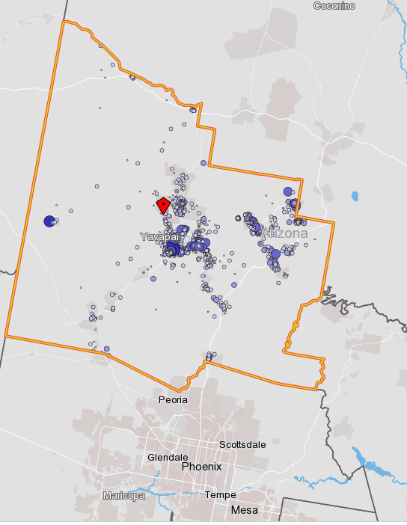
A REGIONAL IDENTITY – Commuting Patterns and Labor Sheds

Slide 34
A REGIONAL IDENTITY – Commuting Patterns and Labor Sheds
The Workers of Yavapai County
18.0% Bachelor’s degree or higher
28.2% have some college experience, but no degree
13.2% Hispanic or Latino
92.9% White
19.4% work in Health Care and Social Assistance
12.5% work in Accommodation and Food Service
13.2% work in Retail Trade
42.3% earn between $1,251 and $3,333 per month
23.7% earn less than $1,250 per month
-United States Census Bureau, Longitudinal Origin-Destination Employment Statistics

Slide 35
A REGIONAL IDENTITY – Commuting Patterns and Labor Sheds
The Workers of Yavapai County
-United States Census Bureau, Longitudinal Origin-Destination Employment Statistics

Slide 36
A REGIONAL IDENTITY – Commuting Patterns and Labor Sheds
The Workers of Yavapai County
-United States Census Bureau, Longitudinal Origin-Destination Employment Statistics
Age Band | Yavapai County | Arizona
Age 29 or Younger | 20.1% | 22.3%
Age 30 -54 | 49.7% | 55.5%
Age 55 or Older | 30.1% | 22.2%

Slide 37
A REGIONAL IDENTITY – Commuting Patterns and Labor Sheds
The Workers of Yavapai County
-United States Census Bureau, Longitudinal Origin-Destination Employment Statistics
Earnings | Yavapai County | Arizona
$1,250 per month | 23.9% | 20.2%
$1,251 to $3,333 per month | 42.2% | 38.3%
More than $3,333 per month | 33.9% | 41.6%

Slide 38
A REGIONAL IDENTITY – Commuting Patterns and Labor Sheds
The Workers of Yavapai County
-United States Census Bureau, Longitudinal Origin-Destination Employment Statistics
Primary Jobs by Distance | Count | Share
Less than 10 miles | 27,979 | 39.8%
10 to 24 miles | 11,435 | 16.3%
25 to 50 miles | 5,386 | 7.7%
Greater than 50 miles | 25,443 | 36.2%

Slide 39
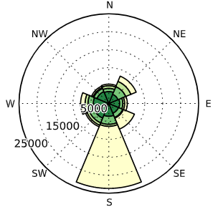
A REGIONAL IDENTITY – Commuting Patterns and Labor Sheds
The Workers of Yavapai County
-United States Census Bureau, Longitudinal Origin-Destination Employment Statistics

Slide 40
A REGIONAL IDENTITY – Commuting Patterns and Labor Sheds
The Workers of Yavapai County
-United States Census Bureau, Longitudinal Origin-Destination Employment Statistics
Destination of Commuters | Count | Share
Prescott | 18,102 | 25.8%
Phoenix | 10,773 | 15.3%
Prescott Valley | 6,369 | 9.1%
Cottonwood | 3,368 | 4.8%
Sedona | 3,282 | 4.7%
Flagstaff | 2,696 | 3.8%
Camp Verde | 2,222 | 3.2%
Scottsdale | 2,110 | 3.0%

Slide 41
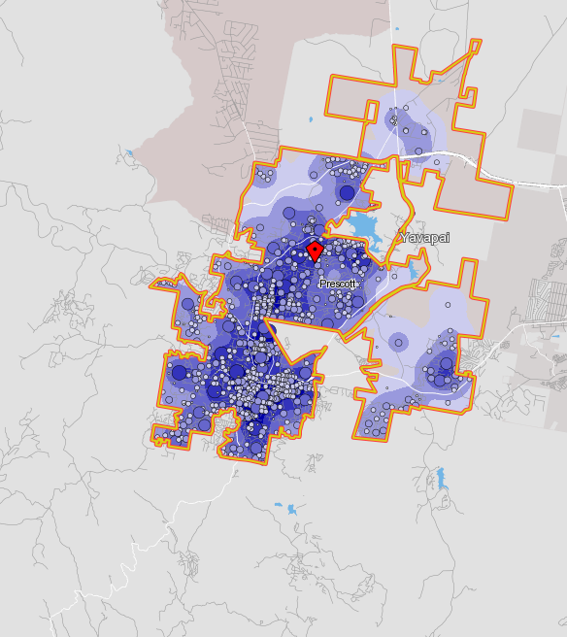
A REGIONAL IDENTITY – Commuting Patterns and Labor Sheds
The Workers of Prescott
-United States Census Bureau, Longitudinal Origin-Destination Employment Statistics
Primary Jobs by Distance | Share
Less than 10 miles | 58.9%
10 to 24 miles | 3.8%
25 to 50 miles | 2.5%
Greater than 50 miles | 34.9%

Slide 42
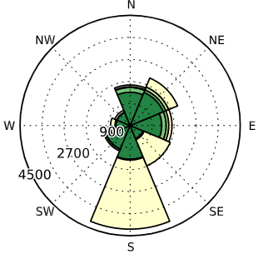
A REGIONAL IDENTITY – Commuting Patterns and Labor Sheds
The Workers of Prescott
-United States Census Bureau, Longitudinal Origin-Destination Employment Statistics

Slide 43
A REGIONAL IDENTITY – Commuting Patterns and Labor Sheds
The Workers of Prescott
-United States Census Bureau, Longitudinal Origin-Destination Employment Statistics
Destination of Commuters | Share
Prescott | 50.0%
Phoenix | 14.7%
Prescott Valley | 7.3%
Scottsdale | 2.8%
Flagstaff | 2.2%
Glendale | 1.6%
Chino Valley | 1.2%

Slide 44
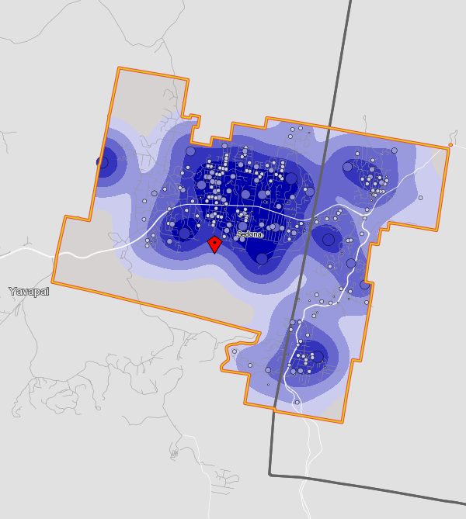
A REGIONAL IDENTITY – Commuting Patterns and Labor Sheds
The Workers of Sedona
-United States Census Bureau, Longitudinal Origin-Destination Employment Statistics
Primary Jobs by Distance | Share
Less than 10 miles | 49.9%
10 to 24 miles | 11.4%
25 to 50 miles | 7.6%
Greater than 50 miles | 31.0%

Slide 45
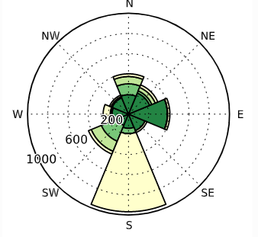
A REGIONAL IDENTITY – Commuting Patterns and Labor Sheds
The Workers of Sedona
-United States Census Bureau, Longitudinal Origin-Destination Employment Statistics

Slide 46
A REGIONAL IDENTITY – Commuting Patterns and Labor Sheds
The Workers of Sedona
-United States Census Bureau, Longitudinal Origin-Destination Employment Statistics
Destination of Commuters | Share
Sedona | 38.0%
Phoenix | 12.1%
Flagstaff | 6.6%
Scottsdale | 3.7%
Cottonwood | 3.5%
Prescott | 2.1%
Oak Creek | 1.8%

Slide 47
A REGIONAL IDENTITY – Impacts of Interconnectedness
The Impacts of Interconnectedness (or the lack thereof)

Slide 48
A REGIONAL IDENTITY – Impacts of Interconnectedness
Business Attraction
Business Retention
Business Growth
Human Capital Supply
Quality of Life

Slide 49
A REGIONAL IDENTITY – Impacts of Interconnectedness
Real Life Questions from Site Selectors
How much private-sector experience do your CTE teachers have?
If I select an Arizona site as a location, will I be able to find the talent I need?
Does the supply chain I need exist in the area I am considering?
Will the public school system in Arizona offer my kids an educational experience comparable to what they would have received in New York?
How many firms with expertise in hot bottling are close to the site?
How many urban fish hatcheries are there in Phoenix?
How many Tucson restaurants have won a James Beard Award?
Describe the work ethic of the Kingman workforce.

Slide 50
A REGIONAL IDENTITY – Impacts of Interconnectedness
Business Attraction
Business Retention
Business Growth
Human Capital Supply
Quality of Life

Slide 51
The War for Talent — A Battle for Employee Attraction and Retention
Area Development Magazine, December 2018
88% of millennials say they want to live in an urban environment within a close distance to their jobs.

Slide 52
The War for Talent — A Battle for Employee Attraction and Retention
Area Development Magazine, December 2018
For employers, the future of their organizations depends a lot upon the location of the real estate that is selected because, for the foreseeable future, they know they will be competing for quality employees.

Slide 53
The War for Talent — A Battle for Employee Attraction and Retention
Area Development Magazine, December 2018
In competing for college recruits, companies will hire first and figure out jobs for recruits later.

Slide 54
The War for Talent — A Battle for Employee Attraction and Retention
Area Development Magazine, December 2018
Retention will become defined by compensation, culture, and creating a positive work environment that is reflected in a company’s sense of “place” or its location.

Slide 55
The War for Talent — A Battle for Employee Attraction and Retention
Area Development Magazine, December 2018
Stakeholder collaboration between state and local government entities, academia, unions, and other organizations is the best way to tackle the skilled worker shortage.

Slide 56
The War for Talent — A Battle for Employee Attraction and Retention
Area Development Magazine, December 2018
In the early stages…the location decision becomes more about site elimination. Eliminating sites will be based on…quantity and quality of the workforce…logistics/transportation, utility infrastructure, energy costs, taxes, permitting, regulatory climate, and quality of life.

Slide 57
The War for Talent — A Battle for Employee Attraction and Retention
Area Development Magazine, December 2018
However, labor is often the No. 1 factor companies consider during the site selection process.

Slide 58
A REGIONAL IDENTITY – Regional Collaboration Strategies and Success Stories
Regional Collaboration Strategies and Success Stories

Slide 59
A REGIONAL IDENTITY – Regional Collaboration Strategies and Success Stories
The Borderplex Alliance in Texas, New Mexico and Juarez
“The time is right for regional collaboration, but that door will not be open forever.”
Notes:
My work involved aligning the region’s CTE programs to identified priority industry sectors.
One of the priority actions of the Borderplex Alliance was improvement of regional infrastructure. Bridge, entry port delays, communications infrastructure, integrated regional airports,

Slide 60
A REGIONAL IDENTITY – Regional Collaboration Strategies and Success Stories
Volkswagen in East Tennessee
“When you’re playing at the level of a company like Volkswagen, there is an expectation that you can connect them to a workforce that is skilled and ready”
-Ron Littlefield, Mayor of Chattanooga
Notes:
Two weeks ago, announced that electric vehicles would be built in Chattanooga.
In June 2018, announced a five-passenger SUB would be built in Chattanooga.
Tennessee, Alabama, Georgia, Chattanooga, Hamilton County
My work involved labor market analysis around basic skills

Slide 61
A REGIONAL IDENTITY – Regional Collaboration Strategies and Success Stories
The Itasca Project in Minnesota
An employer-led civic alliance focused on building a thriving economy and improved quality of life.

Slide 62
A REGIONAL IDENTITY – Regional Collaboration Strategies and Success Stories
The Itasca Project in Minnesota
Calculating the ROI of Transit Investment (2010-2012)
This Itasca Project task force sought to understand the expected economic return on regional transit investments in order to inform the regional conversation on transit expansion.

Slide 63

Regional identity
Cross-disciplinary partnerships
Business-led strategies

Slide 64
Dr. Ron Liss
Yavapai College Vice President
Instruction and Student Development
Economic Leadership Summit

Slide 65
Next Steps
Economic Leadership Summit

Slide 66





Thank You
Richard Hernandez
(928) 776-7332
richard.hernandez@yc.edu
www.yc.edu/redc

